Slide 1
Implier – Architecture
Ben Lackey

Slide 2
FIX vs. STS/TT APIs
FIX is the industry standard for price and trade data
http://fixprotocol.org/
Direct access to many exchanges is via FIX, including
ICE
CME
Old exchanges such as LIFFE are moving to FIX
New exchanges such as the Brazilian Mercantile and Futures Exchange are built on FIX
STS/TT API
Proprietary – an application developed against either API will not be portable to other platforms.
The current version of the TT API is being phased out in favor of a new version
Building our application on FIX will ensure
Independence from any particular vendor’s platform
Future proof the application if go for direct market access or colocation

Slide 3
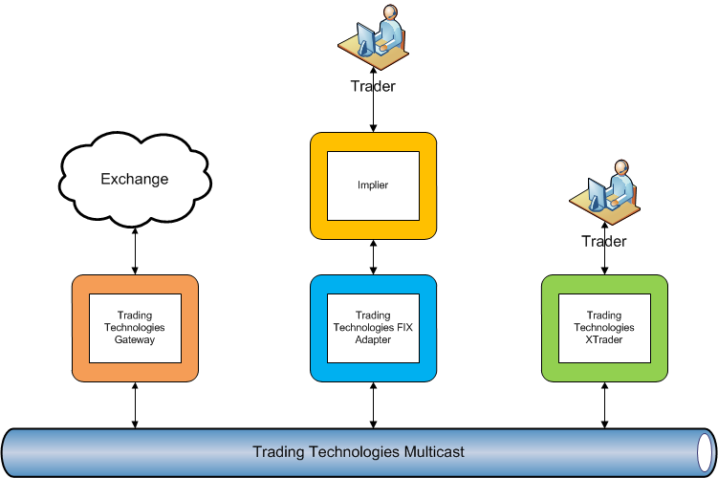
Trading Technologies Architecture

Slide 4
Trading Technologies Architecture
This solution leverages the TT components.
Allowing fast development time
Use Schneider’s existing risk infrastructure
Latency is going to be high in this scenario
Costs
Computer to run XTrader, FIX Adapter and Implier
Use one of Ben’s computers initially
Potentially upgrade later – £2000-£4500
XTrader – £1300/month
FIX Adapter – £1300/month

Slide 5
Server Costs
Server would run
Implier
Trading Technologies FIX Adapter
Trading Technologies XTrader
£2000-£4500 depending on options
Extreme high end shown below:
 |  | Quantity | Price
Server | Intel SR1630BC | 1 | 596.42 | 596.42
Processor | Intel Nehalem | 2 | 1319.97 | 2639.94
Hard Disk | Wester Digital 2TB | 2 | 112.76 | 225.52
Memory | 8x2GB | 8 | 52.04 | 416.32
Operating System | Microsoft Windows Server Standard 2008 R2 | 1 | 631.62 | 631.62
Total |  |  |  | 4509.82

Slide 6
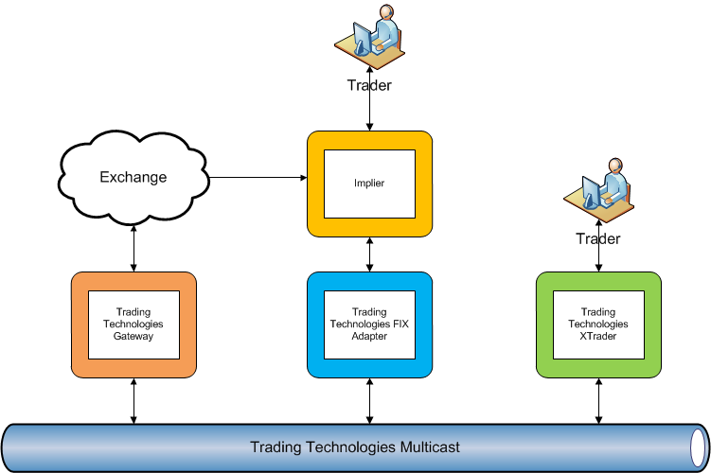
Trading Technologies Architecture with Direct Market Access (DMA)

Slide 7
Trading Technologies Architecture with Direct Market Access (DMA)
Access price data directly from the market
This bypasses the TT gateway, TT multicast and the TT FIX Adapter
Significant reduction in latency – likely on the order of 10-100ms
Execution
Continue to use TT infrastructure for trade execution
This means Schneider’s existing risk system will process all trades.

Slide 8
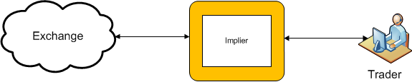
Direct Market Access (DMA)
Massive reduction in latency over the solutions presented earlier
Access via
Leased line
Collocation in exchange

Slide 9
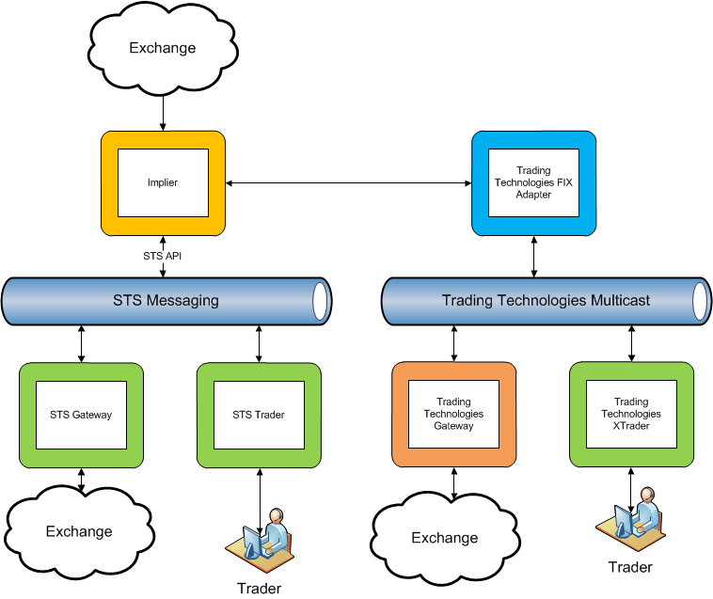
Implier as an Execution Management System (EMS)

Slide 10
Implier as an Execution Management System (EMS)
The Implier could also be used to generate prices for synthetic instruments
For example
WTI might be offered at 100
However, the Implier finds a 5 leg trade that gives WTI at 80
A trader would be presented with a synthetic version of WTI that gives the best price, in this case the 5 leg trade.
This would happen seamlessly. From a trader’s perspective they would be trading the same instrument only seeing better prices than the market at large.

Slide 11
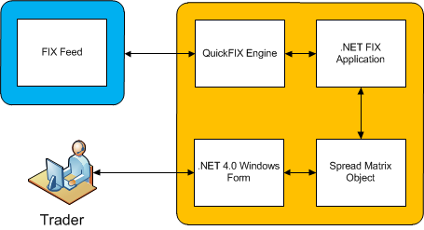
Implier 1.0
FIX Connection either to TT or direct to the market
QuickFIX Engine
http://quickfix.org/
.NET 4.0
Significantly faster than Excel and Visual Basic

Slide 12
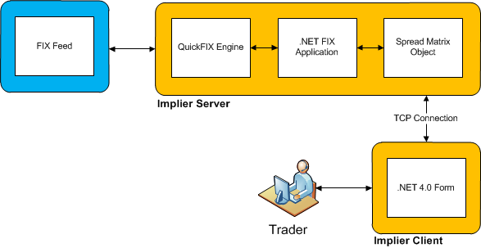
Implier 2.0
Decouple Implier server and client components
Allows the Implier server to run independently of the client interface
This reduces latency for the pure arbitrage scenario
Multiple clients could be supported by a single server

Slide 13
Implier 3.0+
Consider rewriting the engine component in Erlang to take advantage of multicore processors
http://erlang.org/
Would require wrapping QuickFIX engine in Erlang
Consider outsourcing aspects of development to Ben’s Russian contacts
http://quantumsoft.ru/

